Slide 1
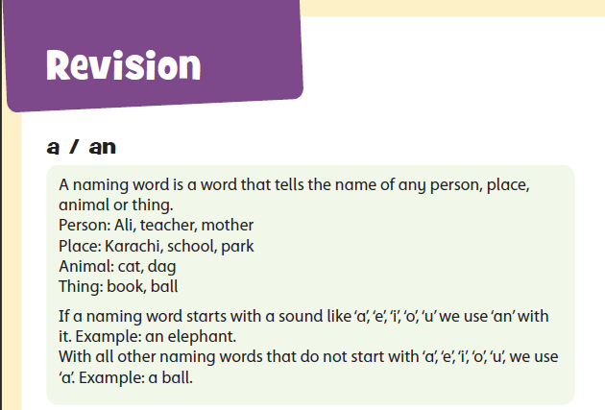
BOOK 1, REVISION
Image for reference: refer to your book for full unit
Starting lecture Lesson at a glance Topic: REVISION Vocabulary: bus, hat, train, doll, blackboard, duster, boy, girl, man, woman Grammar Points: Use of a / an before naming words Using It is… for objects/animals Using He is… / She is… for people Identifying action words (doing words)

Slide 2
a / an (Concept)
Teacher: “Today we will learn how to use a and an with naming words.”
Concept (simple rule):
We use a before words that start with a consonant sound.
Examples: a cat, a dog, a ball
We use an before words that start with a vowel sound (a, e, i, o, u).
Examples: an apple, an egg, an orange
Teacher (gesture):
Left hand = vowels (a, e, i, o, u)
Right hand = consonants
Students repeat the vowel set with the teacher.
Draw on board
Naming word | Use
apple | an
orange | an
cat | a
dog | a
Quick call‑and‑response:
Teacher: “If a word starts with a vowel, we use…?”
Students: “an!”
Teacher: “If a word starts with any other letter, we use…?”
Students: “a!”

Slide 3
Teacher (script):
“a / an help us talk about one thing: a cat, an apple.”
Check:
“Does apple start with a vowel? Do we say an apple?” (Students: yes)
“Does cat start with a vowel? Do we say a cat?” (Students: yes)
“Does orange start with a vowel? Do we say an orange?” (Students: yes)
Show pictures one by one.
Read each naming word aloud.
After each one, ask:
Teacher:
“What sound does it start with?”
“Should we use a or an?”
Invite one student to underline the first letter and another student to say the correct article.
Targets to guide them:
a cat, a dog
an apple, an orange

Slide 4
Action Words (Concept)
Teacher: “Today we will learn about action words. Action words tell us what a person or an animal is doing.”
Concept (simple rule):
Action words are doing words.
They show an action like:
running, jumping, eating, kicking, flying, playing
Teacher (gesture):
Teacher acts each action:
Running (move hands)
Jumping (small jump)
Eating (hand to mouth)
Flying (arms out like wings)
Students copy each action.
Teacher (call‑and‑response):
Teacher: “Action words show doing!”
Students: “Doing!”
Action Words
running
jumping
eating
flying
kicking
Draw on board
Quick check (point and say):
Point to the running child → “running”
Point to the bird → “flying”
Point to the boy with food → “eating”

Slide 5
Teacher (script):
“Action words tell us what someone is doing.”
Check:
“If a boy is moving fast, is he running?” (Students: yes)
“If someone is using their mouth to eat, is that eating?” (yes)
“If a bird moves in the sky, is it flying?” (yes)
Show each picture from the page.
Read one sentence naturally, then again slowly.
Teacher:
“What is he doing?”
“Which action word can we use?”
“Say the action word with me.”
Students point to each picture and say the action word aloud in chorus.
Invite one student to come to the board and underline the action word in a sentence.
Targets to guide them:
The boy: running
The child with food: eating
The bird: flying
The boy kicking ball: kicking

Slide 6
“It is …” (Concept)
Teacher: “Today we will learn how to use ‘It is…’ when we talk about one object or one animal.”
Concept (simple rule):
We use It is… to talk about: things, objects, animals, non‑living items
Examples:
It is a bus.
It is a hat.
It is a train.
It is a doll.
Teacher (gesture):
Hold one hand out flat → “It is…”
Point to an object or picture → “a bus / a hat / a doll”
Students copy the gesture.

Slide 7
Continued …
Teacher (call‑and‑response):
Teacher: “For one object or one animal, we say…?”
Students: “It is!”
Teacher: “Say: It is a bus.”
Students repeat.
Picture | Sentence
bus | It is a bus.
hat | It is a hat.
doll | It is a doll.
train | It is a train.
Draw on board
Quick check (point and say):
(Point to the bus) → “It is a bus.”
(Point to the hat) → “It is a hat.”
(Point to the duster) → “It is a duster.”
Teacher’s note: You may point to any object in the classroom and make similar sentences.

Slide 8
Teacher (script):
“We say It is… when we talk about one object or one animal.”
Check:
“If I show you a bus, do we say It is a bus?” (Students: yes)
“If I show you a hat, do we say It is a hat?” (yes)
“If I show you a doll, do we say It is a doll?” (yes)
Show each picture from the book.
Read the sentence once naturally.
Then re‑read slowly.
Teacher asks:
“Which words come first?” → (It is…)
“What object do you see?”
“Say the full sentence with me.”
Invite one student to come to the board and circle the naming word (bus, hat, train, doll).
Invite another student to underline It is.
Targets to guide them:
It is a bus.
It is a hat.
It is a train.
It is a doll.
It is a blackboard.
It is a duster.

Slide 9
“He is / She is” (Concept)
Teacher: “Today we will learn how to use ‘He is…’ and ‘She is…’ when we talk about people.”
Concept (simple rule):
We use He is… for a boy or a man.
Examples:
He is a boy.
He is a man.
He is a teacher.
We use She is… for a girl or a woman.
Examples:
She is a girl.
She is a woman.
She is a teacher.
Teacher (gesture):
Right hand = “He is”
Left hand = “She is”
Teacher says the phrases; students copy the gesture.

Slide 10
Continued …
Teacher (call‑and‑response):
Teacher: “For a boy or a man, we say…?”
Students: “He is!”
Teacher: “For a girl or a woman, we say…?”
Students: “She is!”
Pronoun | Use
He is | boy/man
She is | girl/woman
Draw on board
Quick check (point and say):
(Point to a picture of a boy) → “He is a boy.”
(Point to a picture of a girl) → “She is a girl.”
(Point to a man) → “He is a man.”
(Point to a woman) → “She is a woman.”
Teacher’s note: You may point to students in the classroom and make sentences.

Slide 11
Teacher (script):
“We use He is… for a boy or a man, and She is… for a girl or a woman.”
Check:
“If this is a boy, do we say He is a boy?” (Students: yes)
“If this is a girl, do we say She is a girl?” (Students: yes)
“If this is a man, do we say He is a man?” (yes)
“If this is a woman, do we say She is a woman?” (yes)
Show each picture one by one.
Read the sentence once normally.
Then read again slowly.
Teacher asks:
“Who is this?”
“Is this a boy or a girl?”
“Should we say He is or She is?”
“Say the full sentence with me.”
Invite one student to underline the pronoun (He / She) in the sentence.
Invite another student to circle the naming word (boy, girl, man, woman, teacher).
Targets to guide them:
He is a boy.
She is a girl.
He is a man.
She is a woman.
He is a teacher.
She is a teacher.

